Slide 1


DNA SEQUENCE ANALYSIS USING BIOPYTHON
SUBMITTED BY :-
UNMESHA MUDULI
3RD YEAR
B.TECH+M.TECH BIOTECHNOLOGY
KIIT UNIVERSITY

Slide 2

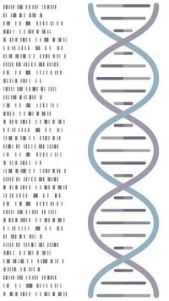
Contents
READING DNA SEQUENCES FROM FILES
CALCULATING GC CONTENT
FINDING SPECIFIC MOTIFS OR PATTERNS
TRANSCRIPTION AND TRANSLATION OF
DNA SEQUENCES
VISUALIZING DNA SEQUENCES

Slide 3

READING DNA SEQUENCES FROM FILES
Reading DNA sequences from files is a fundamental task in bioinformatics. One of the most common file formats for storing nucleotide sequences is the FASTA format. The BioPython library provides a convenient way to handle such files.
Steps to Read DNA Sequences
1. Open the File:
The first step is to open the file containing the DNA sequences. This can be done using standard file handling operations in the programming language of choice (e.g., Python).
2. Parse the File:
Depending on the file format, the file is parsed to extract the sequence data. Parsing involves reading the file line by line and interpreting the content based on the format’s specifications.
3. Store the Sequences:
The extracted sequences are stored in a data structure (e.g., list, dictionary) for easy access and manipulation.

Slide 4
CALCULATING GC CONTENT
GC content, also known as guanine-cytosine content, is a crucial concept in molecular biology, genetics, and bioinformatics. It represents the percentage of nitrogenous bases in a DNA or RNA molecule that are either guanine (G) or cytosine (C). The GC content of a nucleic acid molecule can significantly influence its properties and functions, such as stability, melting temperature, and susceptibility to denaturation.
Nitrogenous Bases in DNA :
DNA is composed of four types of nitrogenous bases:
1. Adenine (A)
2. Thymine (T)
3. Guanine (G)
4. Cytosine (C)

Slide 5
FINDING MOTIFS OR PATTERNS
In molecular biology and bioinformatics, a motif or pattern is a recurring sequence of nucleotides in DNA that has a biological significance. These motifs can be specific sequences of nucleotides that serve particular functions, such as binding sites for proteins, regulatory elements, or conserved regions across different organisms.
Applications of Motif Discovery
Gene Regulation Studies
Evolutionary Biology
Disease Research
Identifying conserved motifs across species to infer evolutionary relationships.
Discovering motifs associated with genetic disorders or cancer.
Understanding how genes are turned on or off in different conditions.

Slide 6
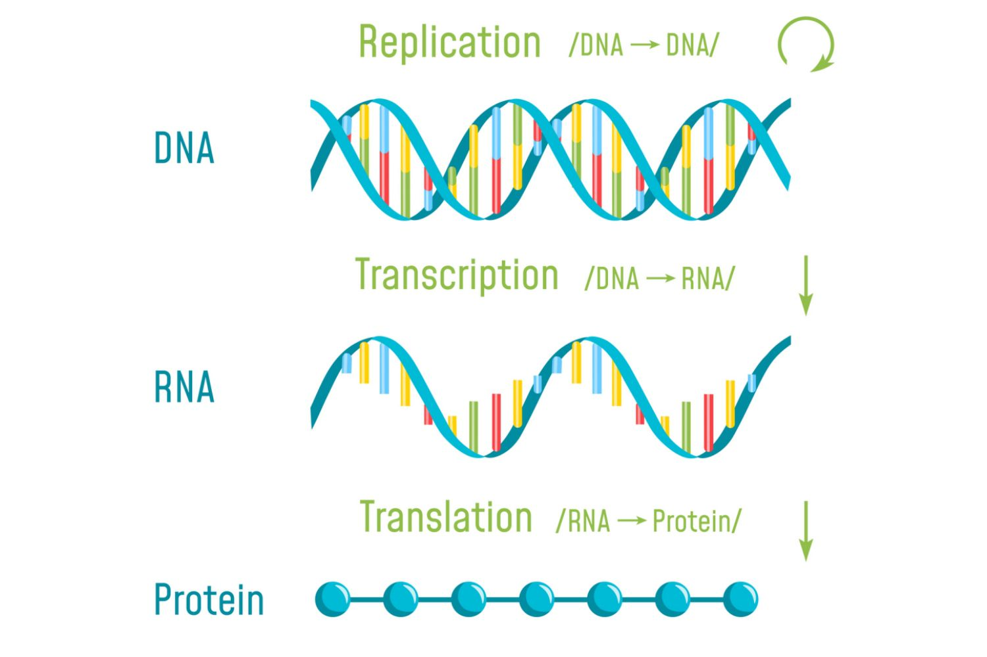
Transcription and Translation of DNA Sequence
Transcription is the process by which a segment of DNA is copied into RNA by the enzyme RNA polymerase. This RNA molecule, specifically mRNA (messenger RNA), carries the genetic information needed for protein synthesis from the DNA in the nucleus to the ribosomes in the cytoplasm.
Steps of Transcription:
Initiation: RNA polymerase binds to a specific region called the promoter on the DNA, signaling the start of transcription.
Elongation: RNA polymerase unwinds the DNA and adds complementary RNA nucleotides (A, U, G, C) to the growing RNA strand.
Termination: When RNA polymerase reaches a terminator sequence, transcription stops, and the RNA molecule is released.
Example:
DNA Sequence: ATGCGTACG
Transcribed mRNA Sequence: UACGCAUGC

Slide 7

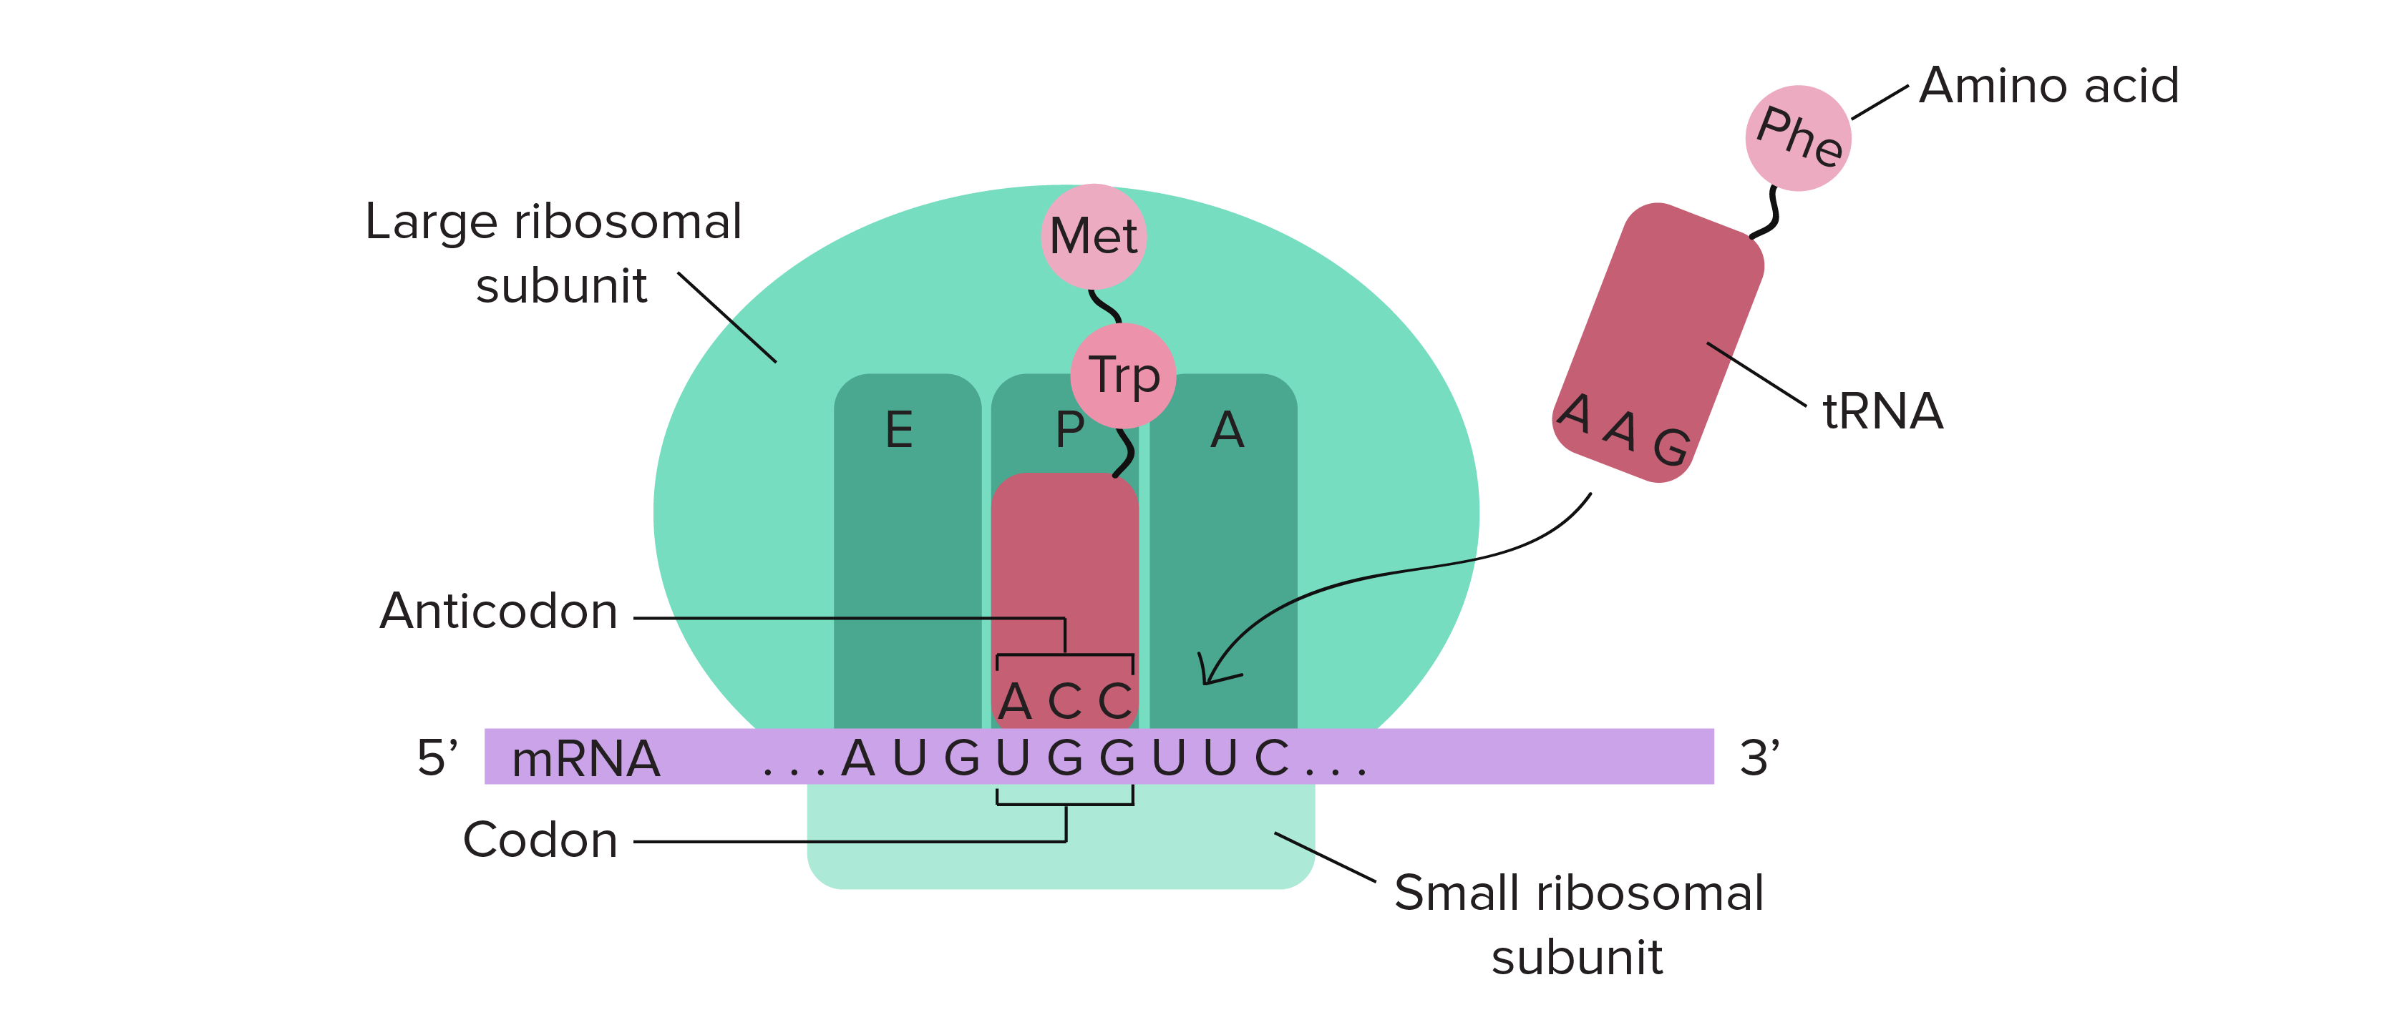
Translation:
Translation is the process by which the mRNA sequence is decoded to build a polypeptide, which folds into an active protein. This occurs in the ribosome and involves transfer RNA (tRNA) molecules that carry amino acids.
Steps of Translation:
Initiation: The ribosome assembles around the mRNA and the first tRNA.
Elongation: tRNA molecules, each carrying a specific amino acid, bind to the mRNA in a sequence-specific manner (codon-anticodon pairing). The ribosome moves along the mRNA, catalyzing the formation of peptide bonds between the amino acids.
Termination: The process continues until a stop codon is reached, signaling the release of the newly synthesized polypeptide.
Example:
mRNA Sequence: UACGCAUGC
Codons: UAC (Tyrosine), GCA (Alanine), UGC (Cysteine)
Genetic Code Table:
UAC → Tyrosine (Y)
GCA → Alanine (A)
UGC → Cysteine (C)
Protein Sequence:
Translated Protein Sequence: YAC

Slide 8
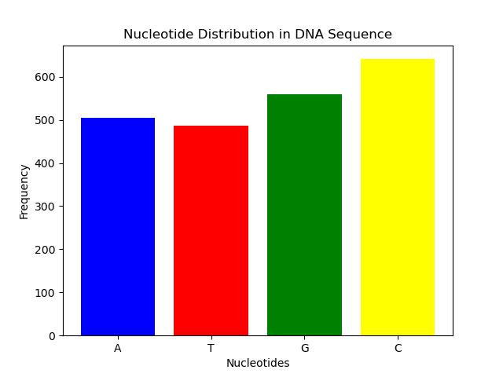
Visualization
The nucleotide distribution graph visualizes the frequency of each nucleotide (adenine (A), thymine (T), guanine (G), and cytosine (C)) in a given DNA sequence. This type of analysis is crucial in understanding the composition and characteristics of a DNA sequence, which can have significant implications in genetic research and biotechnology.
Interpretation of the Graph:
1. X-axis (Nucleotides): The x-axis lists the four nucleotides: A, T, G, and C.
Each bar corresponds to one of these nucleotides.
2. Y-axis (Frequency):The y-axis shows the number of times each nucleotide appears in the DNA sequence.
The height of each bar represents the frequency of the corresponding nucleotide.
Bar Colors:
Blue for Adenine (A)
Red for Thymine (T)
Green for Guanine (G)
Yellow for Cytosine (C)
Graph Analysis
Let's say the graph shows the following bar heights:
Adenine (A): 300
Thymine (T): 250
Guanine (G): 200
Cytosine (C): 250

Slide 9
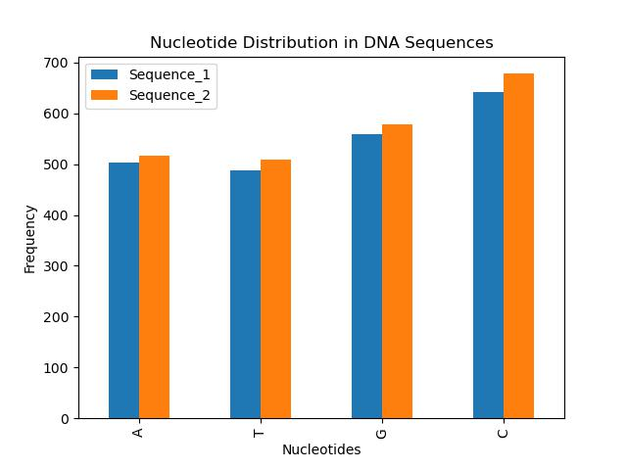
Interpreting the Graph:
1. X-axis (Nucleotides):Represents the four nucleotides: A, T, G, and C. Each nucleotide has its group of bars representing its frequency across different sequences.
2. Y-axis (Frequency):Shows the count or frequency of each nucleotide within the sequences.The height of each bar indicates how frequently a nucleotide appears relative to others in the same sequence.
3. Grouping by Sequences: Bars are grouped together for each nucleotide, allowing comparison of their frequencies across multiple sequences. This grouping helps visualize similarities or differences in nucleotide composition between sequences.
Graph Analysis
Suppose in Sequence_1, the bar heights for nucleotides are:
A: 300
T: 250
G: 200
C: 250
In Sequence_2, the heights might be:
A: 280
T: 260
G: 220
C: 240

Slide 10
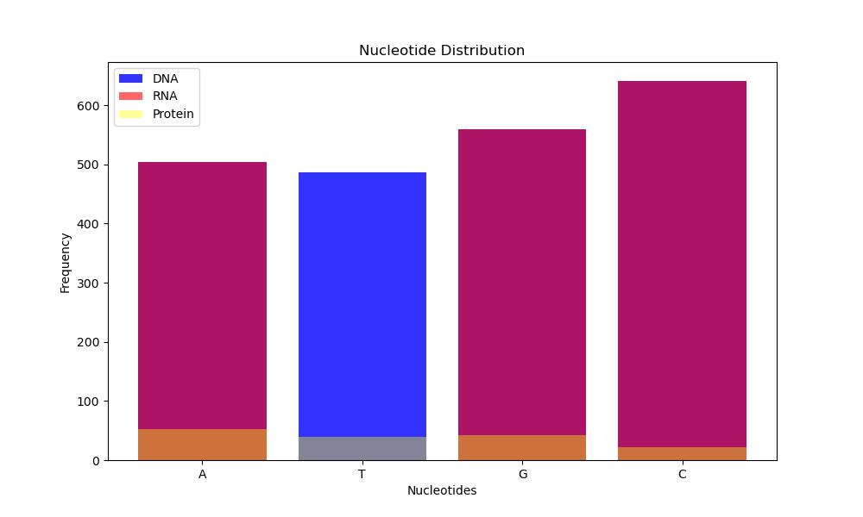
The graph illustrates the distribution of nucleotides (A, T, G, C) across DNA, RNA, and Protein sequences derived from a given DNA sequence.
Key Points of the Graph:
Nucleotide Distribution:
The X-axis represents the nucleotides: A (Adenine), T (Thymine), G (Guanine), and C (Cytosine).
The Y-axis indicates the frequency or count of each nucleotide.
Color Coding:
Each nucleotide type (A, T, G, C) is distinguished by a specific color:
Blue for DNA
Red for RNA
Yellow for Protein
Bar Heights: Each bar's height corresponds to the count of that nucleotide within the respective sequence type (DNA, RNA, or Protein).
For example, the height of the blue bar for 'A' shows how many Adenine nucleotides are present in the DNA sequence, while the height of the red bar for 'A' shows the count in the transcribed RNA sequence, and the yellow bar for 'A' represents the count in the translated Protein sequence.
Interpretation:
DNA Sequence (Blue bars): Shows the original composition of nucleotides in the DNA strand.
RNA Sequence (Red bars): Represents the nucleotide composition after transcription from DNA to RNA.
Protein Sequence (Yellow bars): Illustrates the amino acid composition after translation from RNA to protein.
Insights:
The graph allows quick visual comparison of how the nucleotide composition changes through the processes of transcription and translation.
It highlights any biases or specific patterns in nucleotide usage across different sequence types.
This type of analysis is crucial in understanding genetic information processing and can provide insights into biological functions and evolutionary relationships.
Overall, the graph provides a clear and comparative view of nucleotide distributions across DNA, RNA, and Protein sequences derived from a given DNA sequence, aiding in biological analysis and research.

Slide 11

Thank You

